Slide 1

Computer Programming, Basics
Review

Slide 2
Headlines
Source Control
Linux1
Linux2
Compilers1
Compilers2
Review
Golang1
Golang2
Golang3

Slide 3
What about last Homework? (1)
Create a simple grammer that saves value in a file (instead of printing):
save 1+2;
It means that save the result in a file called: output.txt

Slide 4
What about last Homework? (2)
Create a very simple language that has these grammers:
Assignments:
a = 5;
increment a 5;
It means that increment a by 5.
decrement a 4;
It means that decrement a by 4.
print a;
It will print the value of a.
save a;
It will save the value of a in a file called: save.txt
exit;
Will exit the program.
Your commiter program will commit a random number between 0 and the value saved in save.txt ☺

Slide 5
Source Control
Talking about the history
Source Control models:
Local data model
sccs – source code control system
Client-Server model
svn - Subversion
Distributed model
Git by Linus Torvalds.
Talking about some git command.

Slide 6
Linux
Talking about What is UNIX.
1970 by
Ken Thompson
Dennis Ritchie
And some others at Bell labs.
Linux
1991 by Linus Torvalds
Talking about Linux folders like
/proc
/bin
/dev
Talking about some popular Linux commands.
Talking about Linux distros, package management and services.

Slide 7
Compiler
Talking about compiler phases:
Lexical analyzer
Syntax analyzer
Semantic analyzer
Intermediate code generator
Intermediate code optimizer
Code generator
Code optimizer
flex/lex
Yacc/bison

Slide 8
Go language
First appeared at 2009
Designed by:
Robert Griesemer
Rob Pike
Ken Thompson
Implementation Languages:
Go, Assembly Language (gc), C++ (gccgo)
Statically typed
Built-in http, json, xml
Compiled
Concurrency
Built-in testing
Go is a minimalist language
Notes:
Go is a minimalist language, and that’s (mostly) a blessing.
The formal Go language specification is only 50 pages, has plenty of examples, and is fairly easy to read. A skilled programmer could probably learn Go from the specification alone.
Concurrency is an integral part of Go, supported by goroutines, channels and the select statement.
The built-in frameworks for testing and profiling are small and easy to learn, but still fully functional. There are plenty of third-party add-ons, but chances are you won’t need them.

Slide 9
Advantages & Disadvantages
Advantages
Disadvantages
Clean syntax
Powerful standard library
Garbage Collection
Fast learning
Backed by Google
Open Source
Fast compile time
No manual memory management
A young language, so it is still developing
Too simple
Runtime safety is not that good
Notes:
Pro: The simplest reason to start programming in GoLang is its simplicity. The syntax is extremely small and easy to learn. Because its core resembles that of C/C++, experienced programmers can pick up the basics fast.
1) A young language, so it is still developing
Being a very young language, developers might find it difficult to make maximum use of the libraries. They might have to write the libraries themselves and there aren’t many books or online courses to help, while in doubt.
2) Absence of manual memory management
Manual memory management is important, and the lack of it could lead to overhead garbage collection, issues like pauses, which in turn could lead to system programming.
3) Too simple
The simplicity of the language could be an issue, as it makes it superficial. And in an effort to make it simple, the language wasted several years of programming language progress.
4) Error handling isn’t perfect
Though error handling is not perfect in Go, the imperfectness of it could get you. Solutions are still being searched for, and proposals have come up for error handling.
5) Runtime safety is not that good
Go is safe, but it doesn’t deliver the level of the safety that Rust provides. The safety level is compile-time only and to a certain extent runtime. Go focuses on the speed of production, and Rust concentrates on the safety aspect.

Slide 10
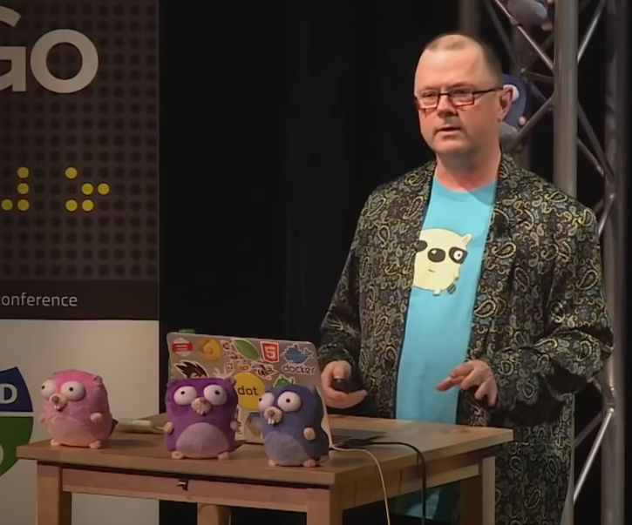



Slide 11

Go Team at – Google I/O 2012

Slide 12




Golang’s GitHub

Slide 13
Hello world!
package main
import "fmt"
func main() {
fmt.Println("hello world")
}
$ go run hello-world.go
$ go build hello-world.go

